Slide 1
Stress Driven
Development
Dmitry Vinnik, @DmitryVinnik
Lead Software Engineer, Salesforce
Notes:
Joke about not stress testing

Slide 2
What are our goals?
Goals
Better Understanding of Stress
Practices of Dealing w/ Stress
How to Move Forward

Slide 3
Stress
Why would we talk about it?

Slide 4
Let’s look externally first

Slide 5
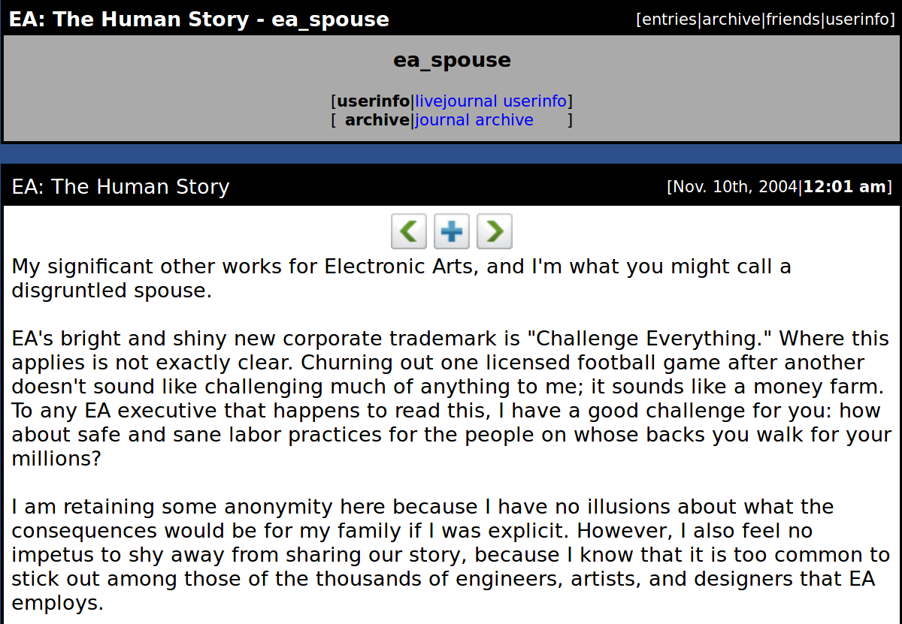
@ea_spouse, https://goo.gl/eQBYxh

Slide 6
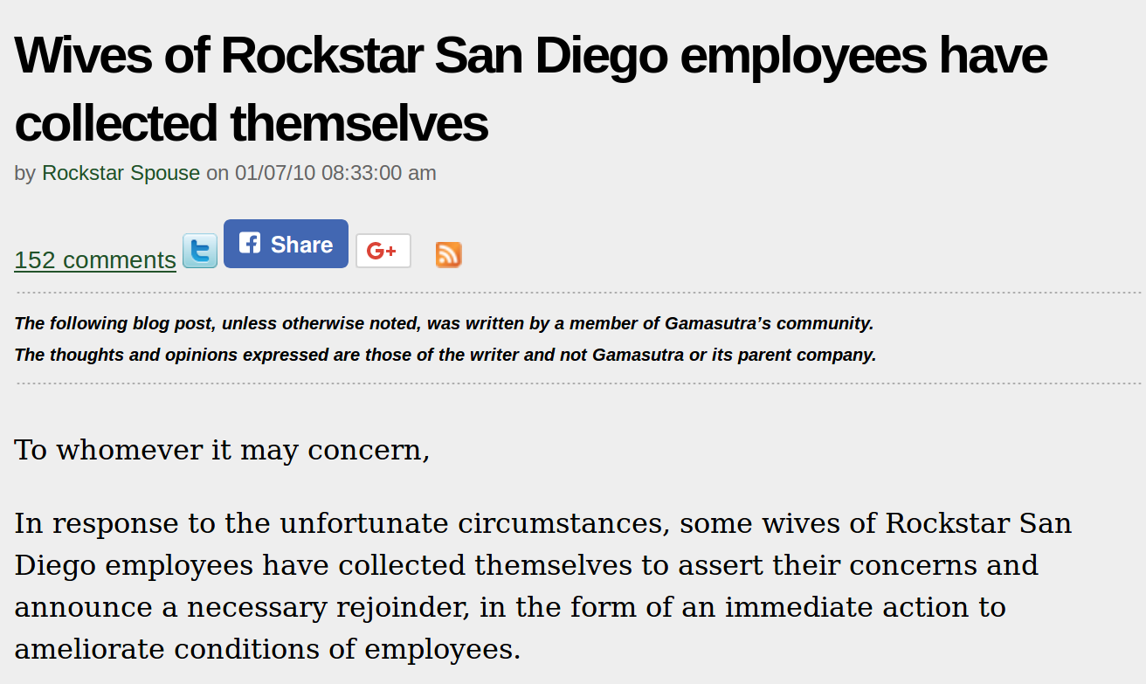
Rockstar Spouse, https://goo.gl/2sqyhh

Slide 7
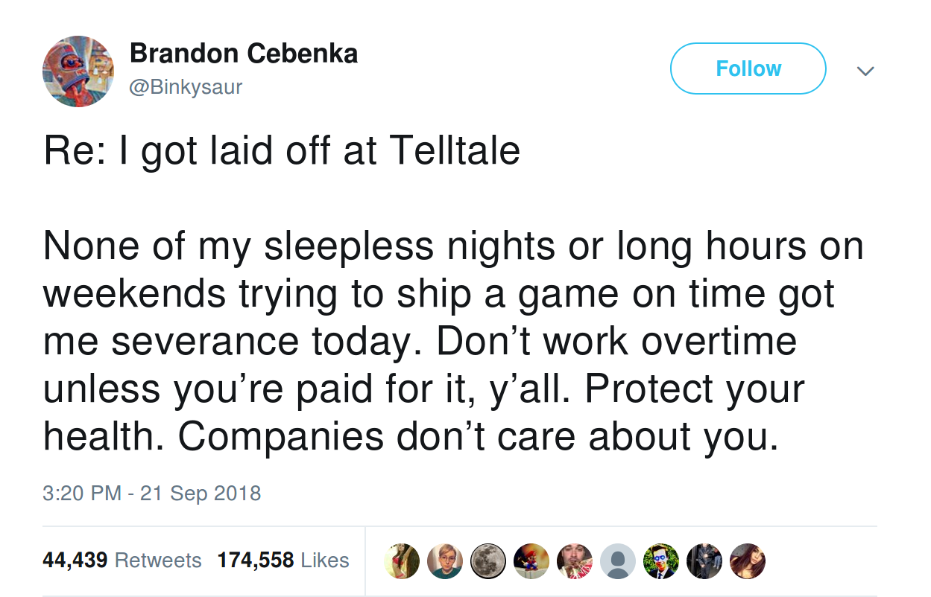
@Binkysaur, https://goo.gl/h9TQad

Slide 8
There are many more cases
Externally
Internally too?

Slide 9
What about
your colleagues?
your family?
you?

Slide 10
Will share my story
Fall, 2015
Something felt off
Notes:
Early 20s
Eager to work, HR had to kick me out
Full-time work and school
Immigration Process in Canada

Slide 11

Reference: Pixabay
Notes:
Reference: https://pixabay.com/en/emergency-emergency-services-1137137/

Slide 12
Unwanted Experience
Very Beneficial
But

Slide 13
It became my motivator
Motivators
Fear
Purpose
Religion
Community
Notes:
Motivators:
Fear
Death
Lower Quality of Life
Purpose
Birth of Kids
Religion
Community
Alcoholics Anonymous are very succesful

Slide 14
Great, we found motivation!
Now what?

Slide 15
Identify the problem
Is all Stress bad?
No

Slide 16
Nature is smart
Purpose of Stress
Fight
Flight
Sleep
Hunger
Notes:
Nature is smart -> No reason to leave something if unnecessary
Goals of Stress:
Fight or Flight response
Sleep deprivation -> long hunts, trailing an animal
Hunger -> body stores energy during diets and when we were unsuccessful hunters

Slide 17
If Stress makes sense...
Why do I feel so bad?
Notes:
If it is so inherently good, why does it feel bad to be stressed?
Why do I get unwanted weight, insomnia, anger issues, etc.

Slide 18
Types of Stress
Short-Term
Long-Term
Notes:
Short Term:
Acute stress
Heat shock (sauna and cold shower)
Long Term:
Long state of distress
Body energy is exhausted

Slide 19
Conclusion?
Incorporate
Short-Term Stress
Eliminate
Long-Term Stress

Slide 20
Easier said than done
There is a good old trick
But

Slide 21
Divide and Conquer!
Grounds for Stress
Grounds for anti-Stress
Sleep
Nutrition
Nutrition
Fitness
Fitness
Work
Work
Notes:
Our Daily routine is a potential for stress
There are many opportunities for Stress, but
Let’s make it opportunities for anti-Stress (relaxation playground)
Stress can reside on all levels
Need a comprehensive, planned approach to fight it
Keep the most obvious, Work to last

Slide 22
Why Sleep?
Do you need a reason?

Slide 23
Reasons to Sleep
Depression
Diseases
↑ Creativity
↑ Memory
Notes:
Emotions swings of different kinds
Diseases such as Cancer, Alzheimer's
Lean mass, not losing weight
Better focus
Memory is flushed (reason why we say “let’s sleep on it”)
Skills learning stage

Slide 24
Still need convincing?

Slide 25

Book Suggestion
Notes:
Book Link: https://www.amazon.com/Why-We-Sleep-Unlocking-Dreams/dp/1501144316 Matthew Walker PhD

Slide 26
Great
But how should we sleep?
Now we know why to sleep

Slide 27
Path to Healthy Sleep
Light & Noise
Pollution
Controlled Environment
8 Hours,
Uninterrupted
Constant Wake Time
Notes:
Pollution Fixing
Avoid Bluelight
Night Shift - iPhone
Redshift - Linux Laptop
Felix Gray - glasses
Avoid Light
Polar Bear eye mask
Avoid Noise
Ear Plugs
Controlled Environment
Temperature Control
Cooler in the evening
Warmer in the morning
Cleanliness should be maintained
Uninterrupted 8 hours
No Drinking 2 hours before
No exercising
No napping right before
No stressors
On wake time
Things happen, but try to wake up at the same time
Nap

Slide 28
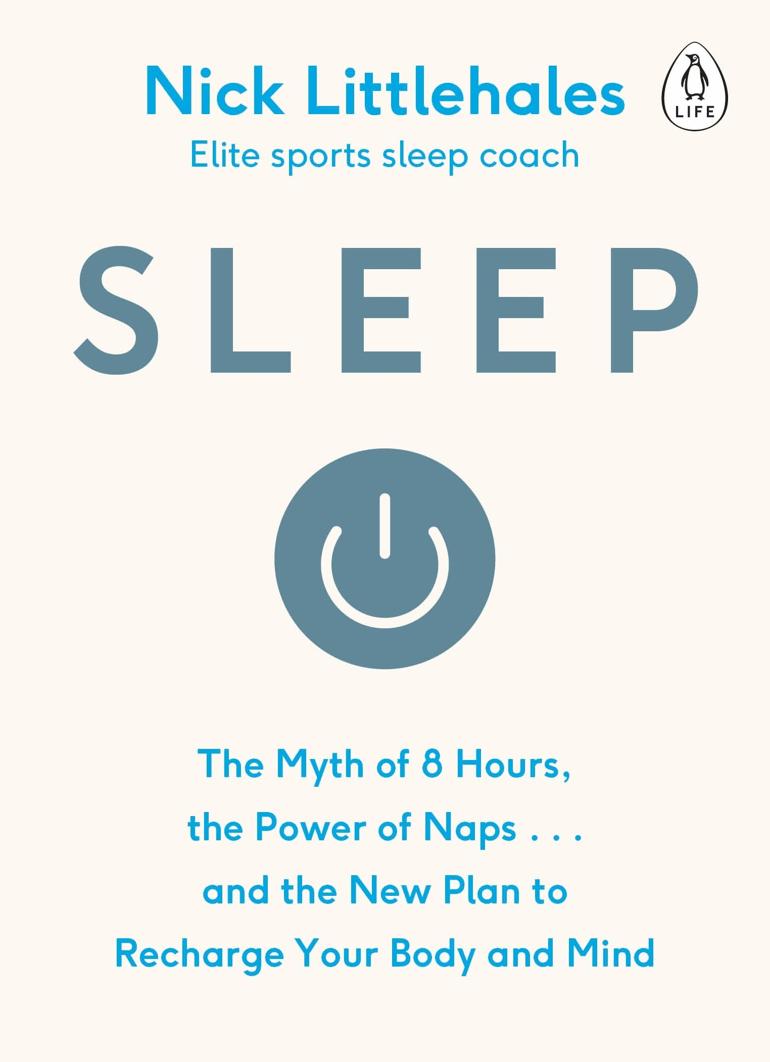
Book Suggestion
Notes:
Book Link: https://www.amazon.com/Sleep-Myth-Hours-Power-Recharge-ebook/dp/B073P4BW6B

Slide 29
Grounds for anti-Stress
Sleep
Nutrition
Sleep
Nutrition
Nutrition
Fitness
Fitness
Work
Work

Slide 30
“You are
what you eat”
by Anthelme Brillat-Savarin

Slide 31
General Nutrition
Diets
Experiment
↓ Sugar
↑ Greens
Notes:
Why not diets
Moderation is the key
Studies have shown that many people eat their way back and gain additional weight
Experimenting
Everyone is unique, and you need to find what works for you
Keep track of nutrientsSupplements!
General advice
Less sugar (note on the carbs)
More greens (including veggies)
Keep moderation in check
Might use mixer like MagicBullet
Focus on macronutrients, not on calories (Sodium, carbs, fats)

Slide 32
Key to Food Control
Intermittent Fasting
16/8 Model
12→20
13→21
Stuffed Feeling
Longevity
Studies

Slide 33
Podcast Suggestions
Ben Greenfield
Model Health Show
Human Optimization Hour
Notes:
Book Link: https://www.amazon.com/Power-Habit-What-Life-Business/dp/081298160X

Slide 34
Heard that before
Sounds easy
Difficult in practice

Slide 35
Habits
Drivers of Daily Routines
Notes:
Nutrition, Sleep, Fitness - what is it if not Daily Routines?

Slide 36
Same rules for all Habits
Habit Loop

Slide 37
Habits Loop
Routine
Routine
Cue
Reward
Notes:
Joke about not being a loop
Focus on Changing the Routine
Example:
Woman was biting nails because she felt pressure in her fingers (Cue)
Reward was a feeling of satisfaction
Changed the routine to be sitting on her fingers

Slide 38
Ready for a change
But seems to be a lot

Slide 39
Keystone Habits
Stick to It
Changes
Behaviour
Small Wins
Ripple Effect
Notes:
Keystone Habits
Changes in your behaviour that effect other areas of your life
Example
Exercises
Focus on Safety
Small Wins
Examples
Michael Phelps and his routine
Completing ToDos
Weight loss

Slide 40
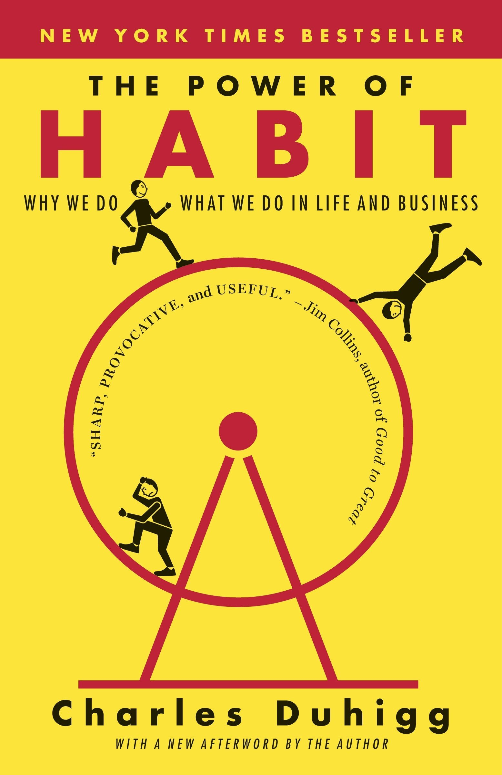
Book Suggestion
Notes:
Book Link: https://www.amazon.com/Power-Habit-What-Life-Business/dp/081298160X

Slide 41
Grounds for anti-Stress
Sleep
Nutrition
Nutrition
Sleep
Nutrition
Nutrition
Fitness
Fitness
Fitness
Work
Work

Slide 42
Fitness
Physical
Mental
Mental

Slide 43
Physical Fitness
Keystone
Habit
Requires Variations
Requires Variations
Requires Integration
Requires Integration
Provides
Flexibility
Provides
Flexibility
Notes:
To reinforce the habit, just put cloth next to your bed every morning

Slide 44
Fitness as a Habit
Identify Triggers
Establish
Reward
Establish
Goals
Find Community
Notes:
Triggers
Cloths in the morning
Timeslot in your calendard
Reward
Gamify your workout
Setting goal
Establishes belief
Example
Sign up for marathon, short run
Finding Community
Part of the belief system that establish habits for a long run

Slide 45
Gamification Suggestions
Strava
MyZone Tracker
Wearables
Notes:
Book Link: https://www.amazon.com/Power-Habit-What-Life-Business/dp/081298160X

Slide 46
Physical Fitness
Keystone
Habit
Keystone
Habit
Requires Variations
Requires Variations
Requires Variations
Requires Integration
Requires Integration
Provides
Flexibility
Provides
Flexibility
Notes:
To reinforce the habit, just put cloth next to your bed every morning

Slide 47
Fitness Variation
Acute Stress
Vary Cardio
Vary Focus
Incorporate
Yoga
Notes:
Acute Stress
Heat shock in sauna
Cold shower in the morning
Example
Running in cold weather
Experiment with Cardio
Try running, spin classes, competions
Note: Health first, think moderation and proper equipement
Note: Don't overdo it!
Yoga
It is in between Mental and Physical fitness
Experiment with different kinds of Yoga
Great for core strength
Twice a week

Slide 48
Physical Fitness
Keystone
Habit
Keystone
Habit
Requires Variations
Requires Variations
Requires Variations
Requires Variations
Requires Integration
Requires Integration
Requires Integration
Provides
Flexibility
Provides
Flexibility
Notes:
To reinforce the habit, just put cloth next to your bed every morning

Slide 49
Fitness Integration
Active Commute
Mark in Calendar
Desk Type Rotation
Boredom Plan
Notes:
Active Commute
Biking, scooter
Running
Walking
Mark in Calendar
Treat as an important task in your day
Desk Type Rotation
Standing Desk
Treadmill Desk
Fitness Ball
Boredom Plan
When we are bored, snaking
Exercise, go for walk

Slide 50
Physical Fitness
Keystone
Habit
Keystone
Habit
Requires Variations
Requires Variations
Requires Variations
Requires Variations
Requires Integration
Requires Integration
Requires Integration
Requires Integration
Provides
Flexibility
Provides
Flexibility
Provides
Flexibility
Notes:
To reinforce the habit, just put cloth next to your bed every morning

Slide 51
Flexibility of Fitness
Morning Routine
Workout + Travel
Bodyweight Exercises
Active Sightseeing
Notes:
Morning Routine
Set positive outlook for the day
Don`t feel guilty the entire day
Many Travel for clients
Go to the gym right away
Bodyweight exercises are great
Planking
Running (cardio)
Active Sightseeing
Walking/Biking Tours

Slide 52
Fitness
Physical
Physical
Mental
Mental
Mental

Slide 53
Mental Fitness
Mindfulness
Controlling Emotions
Clearing Your Mind
Controlling Emotions
Embracing Solitude
Embracing Solitude
Incorporating Meditation
Incorporating Meditation
Notes:
Mindfulness
Being present in the moment
Personal
Couldn`t understand it - felt somewhat elitist
Until I was finishing off my run and one of the audiobooks I was listening to defined Mindfulness for me again
Running exhausted me, so I was able to concentrate

Slide 54
Clear Mind
Information Overload
Information Dump
Source of Truth
Single Focus
Notes:
Too much information
Don`t simply have hundreds of notes in your house
Organize them into a single source of truth (app that you will use)
Evernote

Slide 55

Book Suggestion
Notes:
Book Link: https://www.amazon.com/Subtle-Art-Not-Giving-Counterintuitive/dp/0062457713

Slide 56
Mindfulness
Controlling Emotions
Controlling Emotions
Clearing Your Mind
Controlling Emotions
Clearing Your Mind
Embracing Solitude
Embracing Solitude
Incorporating Meditation
Incorporating Meditation

Slide 57
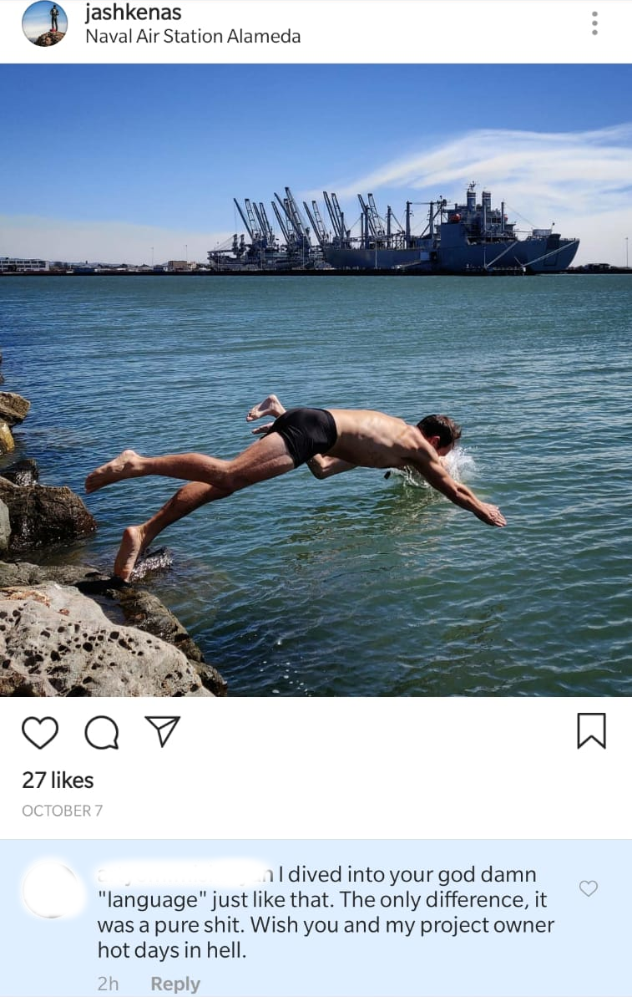
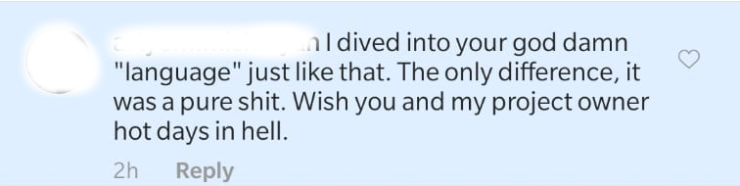
Jeremy Ashkenas, https://goo.gl/PeBRku
Notes:
Creator of CoffeeScript, Backbone.js, Underscore, etc.

Slide 58
Focus on Positive Emotions
No Reasons to be Rude
Art of Unsent Letters
Focus Improvements
Focus on Success
Proactive Feedback
Notes:
Never a good reason to be rude - no benefit
Angry letter
Abraham Lincoln used to write letters when angry but never send them
Not always need for a rush for constant improvements - stop and appreciate what was done
Share proactive, positive feedback
Tell them (juniors) that they have a talent
Example
Coby O'Brien and his father story - 11 years old, zero points, got positive feedback has been working ever since

Slide 59
Talk Suggestions
Brett Cannon on Kindness
Changelog Episode
Notes:
Book Link: https://www.amazon.com/Power-Habit-What-Life-Business/dp/081298160X

Slide 60
Mindfulness
Controlling Emotions
Controlling Emotions
Controlling Emotions
Clearing Your Mind
Controlling Emotions
Clearing Your Mind
Embracing Solitude
Embracing Solitude
Embracing Solitude
Incorporating Meditation
Incorporating Meditation

Slide 61
Art of Solitude
Quiet Moments
Float Therapy
Learn About Yourself
Clear Judgements
Notes:
Going to nature
Remove headphones
Float Therapy
Sensory deprivation capsule
90 minutes
Understanding yourself and appreciating yourself
Remove fears of staying alone (or without a job) -> removes stress and lets to make clear judgements

Slide 62
Mindfulness
Controlling Emotions
Controlling Emotions
Controlling Emotions
Clearing Your Mind
Controlling Emotions
Clearing Your Mind
Embracing Solitude
Embracing Solitude
Embracing Solitude
Embracing Solitude
Incorporating Meditation
Incorporating Meditation
Incorporating Meditation

Slide 63
Meditation
Unguided Meditation
Guided Meditation
Active Meditation
Consistency is Key
Notes:
Unguided Meditation
Great to get into zone without distraction
Guided Meditation
Best place to start
Active Meditation
Staying in the moment when working out
Consistency
10 minutes is not too much
Tony Robbins, “If you don`t have 10 minutes for yourself, you don`t have life”

Slide 64
Need help to get started?
Notes:
Doesn`t have anything to do with religion

Slide 65
Apps Suggestions
Headspace
Relax Meditation
Calm
Notes:
Headspace is especially great to get started

Slide 66
Sceptical of Meditation?
Notes:
Doesn`t have anything to do with religion

Slide 67

Book Suggestion
Notes:
Book Link: https://www.amazon.com/10-Happier-Self-Help-Actually-Works/dp/0062265431

Slide 68
Grounds for anti-Stress
Sleep
Nutrition
Nutrition
Sleep
Nutrition
Nutrition
Fitness
Fitness
Work
Fitness
Fitness
Work
Work

Slide 69
Main Sources
of Work Stress
Office Environment
Communication
Communication
Distractions
Distractions
Project Planning
Project Planning

Slide 70
Office and You
Open Office
Office Perks
Office Bribes
Work on Plane
Work is just Work
Notes:
Open office is nightmare
Otherwise, people would not have been looking for ways to find privacy, quite space, etc.
People (primarily, managers) end up using meeting rooms as their offices
Interestingly, I found some salespeople like it more
Don`t fall for Office perks
Example: Dinner for staying late
It is a bribe
Work is a balance where you trade your life energy (your time) for money
DHH - Work takes, Life gives
Work on Plane dilemma
We get more work done on a plane or in a cafe rather than on our workplaces
Consider remote work
Work is just work
Don’t make it about status, friends, “family”
Can do it on your own time

Slide 71

Book Suggestion
Notes:
Book Link: https://www.amazon.com/Remote-Office-Required-Jason-Fried/dp/0804137501

Slide 72
Main Sources
of Work Stress
Office Environment
Office Environment
Communication
Communication
Communication
Distractions
Distractions
Project Planning
Project Planning

Slide 73
Communication
Reach Time
Synchronous
Response Time
Asynchronous
Setting Expectations
Names to Faces
Notes:
Always prefer asynchronous communication
Emergencies should be unique
Instant Messaging does not mean instant replies
Ignore but don`t forget
Make sure expectations are clear
Might expect to get a reply instantly or on Weekends
Note: the worst when you get email on weekend with “don’t bother to reply until Monday”
Lead by example and don`t reply
Note: France outlawed this behaviour
Put your face as an avatar so people still feel like they work with people (and use webcam when possible)

Slide 74
Main Sources
of Work Stress
Office Environment
Office Environment
Communication
Communication
Communication
Communication
Distractions
Distractions
Distractions
Project Planning
Project Planning

Slide 75
Distractions
Mobile Devices
Noise Control
Noise Control
Setting Boundaries
Setting Boundaries
Getting into Zone
Getting into Zone
Notes:
Mobile devices can be useful
but also can be time waster and stress source
Noise control in the office settings full of stressors
Controlling your environment
Getting into focused state

Slide 76
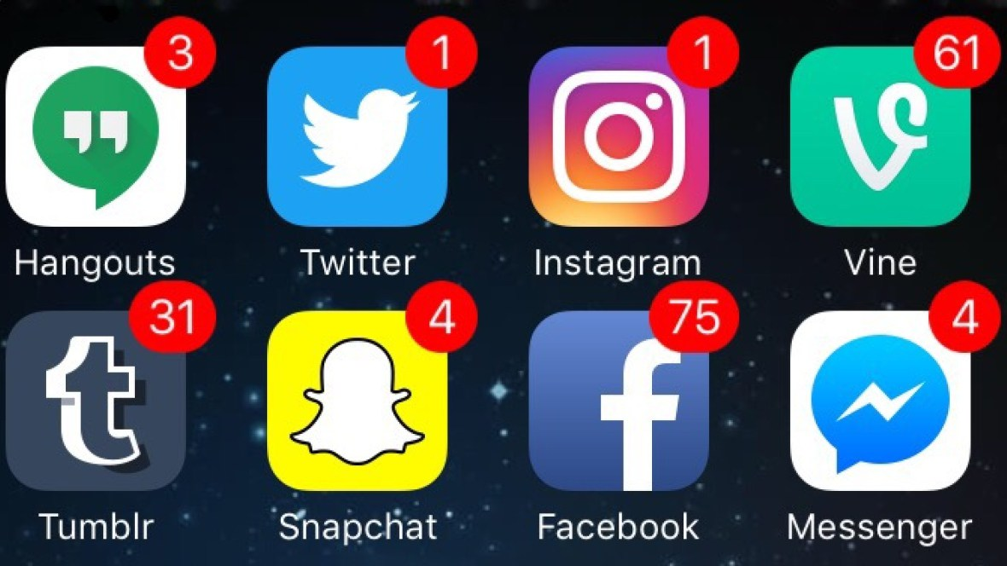
Before:
Notes:
References: https://my-thai.org/two-minutes-just-quickly-checking-ig/

Slide 77
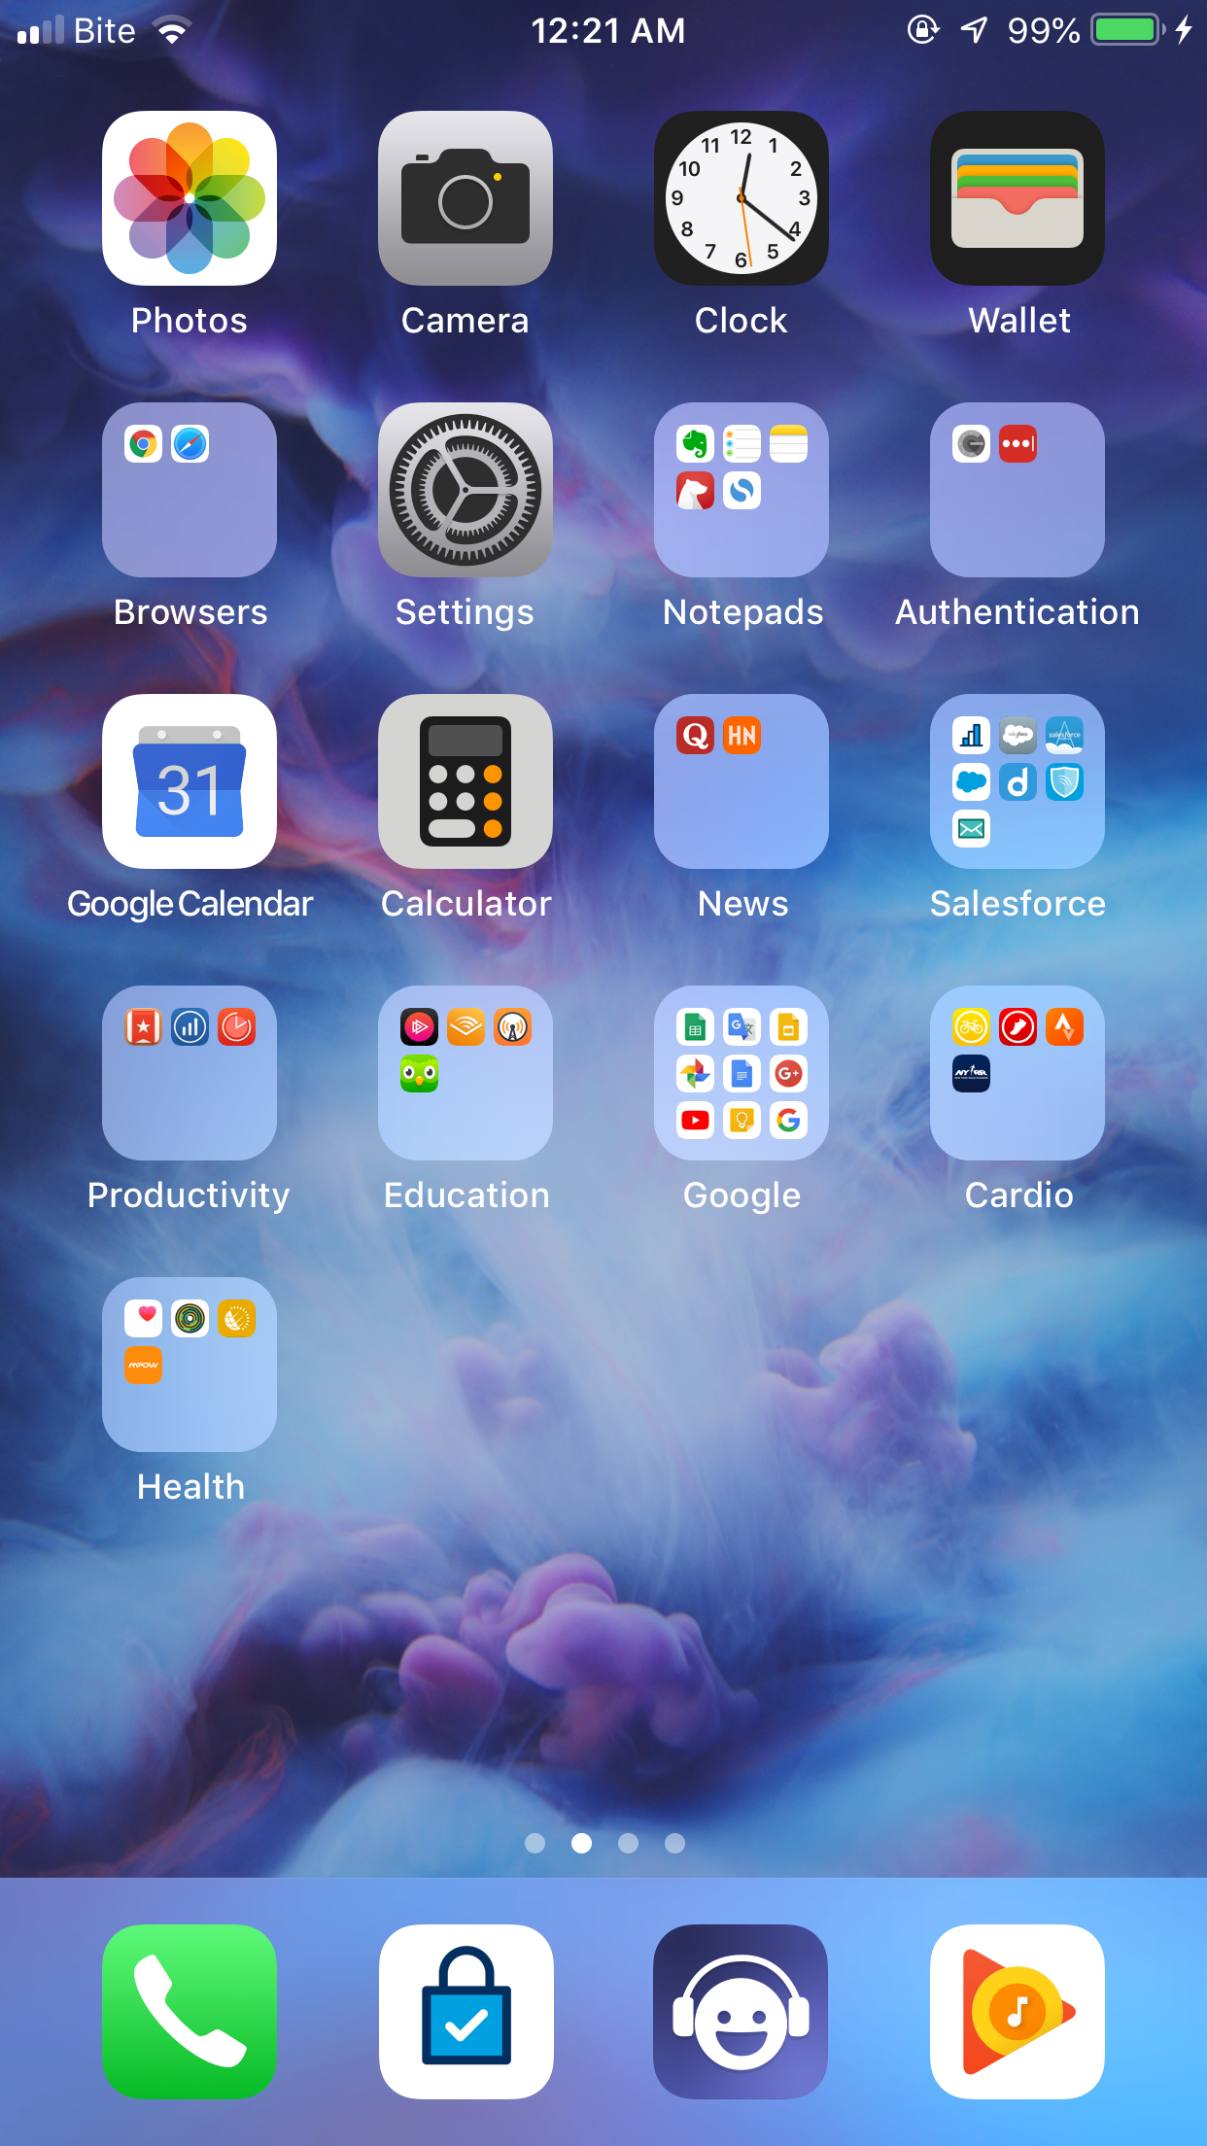
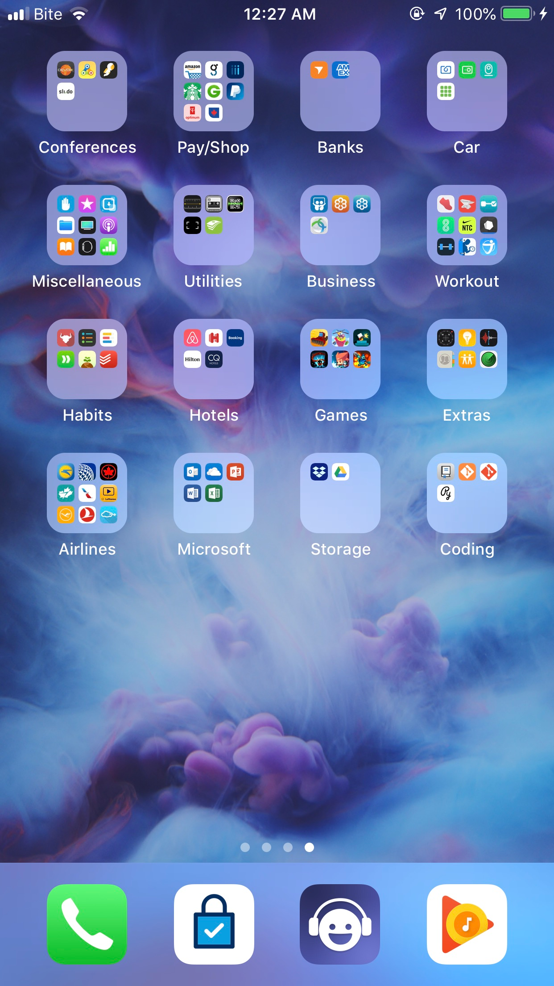
After:
Notes:
Note:
No Notification popups
All messaging apps are moved away from easy access
Apps are grouped
Reference: My Phone

Slide 78
Mobile Devices
Arrange Apps
Disable Notifications
Don’t Disturb Mode
Put Phone Away
Notes:
Potentially even delete apps
Move messaging to the next screen
No notifications
Disable corporate account (at least after work)
Don`t Disturb Mode always on
Who calls these days anyways?
My phone number is online and the phone calls I get from scammers on taxes
Put your phone arm length away from you - makes a huge difference

Slide 79
Distractions
Mobile Devices
Mobile Devices
Noise Control
Noise Control
Noise Control
Setting Boundaries
Setting Boundaries
Getting into Zone
Getting into Zone

Slide 80
Noise Control
Meaningless Noise
Sound Support
Notes:
Benefits
studies shown that sitting in a cafe, people can focus more
it is all about the noise being meaningless to us
Sound Support

Slide 81
Apps Suggestions
Brain.fm
Spotify
MyNoise
Notes:
Headspace is especially great to get started

Slide 82
Noise Control
Meaningless Noise
Sound Support
Noise Cancellation

Slide 83
Solutions Suggestions
Ear Plugs
Earmuffs
Noise Cancelling Headphones
Notes:
Headspace is especially great to get started

Slide 84
Noise Control
Meaningless Noise
Sound Support
Noise Cancellation
Library Rules

Slide 85
Library Rules
Keep Quiet
Async
Ping First
Establish Office Hours
Discuss the Rules
Notes:
If need to discuss something, go to the room
Ping someone before interrupting them
Crucial for experts to have office hours like in academia
Make sure everyone agrees on what rules you want to follow as a team

Slide 86
Main Sources
of Work Stress
Office Environment
Office Environment
Communication
Communication
Communication
Communication
Distractions
Distractions
Distractions
Distractions
Project Planning
Project Planning
Project Planning

Slide 87
Project Planning
Low Hanging Fruits
Dogfooding
Parkinson’s Law
Conway’s Law
Notes:
These projects are unknown and ever harder to plan for
Dogfooding is the key
Know you your domain
Try other products in your area
Example: Wordpress, Squarespace, WIX
Parkinson’s Laws
“work expands so as to fill the time available for its completion”
Stop scope creep early, no benefit in it
Parkinson's law of triviality
Nuclear plant committee primarily focused on discussing what material bikeshedding should be made of
Conway’s Law
Your design will match your organization’s structure
Begin with the team

Slide 88
More Sources
of Work Stress
Long Hours
Productivity &
Effectiveness
Productivity &
Effectiveness
Notes:
Overworking is an issue
Productivity
state of being productive
Effectiveness
producing desired result

Slide 89
Overwork/Long Hours
Creatures of Habit
Unreasonable Expectations
150% + 50%
100% + 100%
Major Regret
Notes:
If we work long hours, we will keep doing it
Especially consultants, hard to know when the day stops and where it starts
Establish boundaries
Expectations should be very clear
with you team
with your boss
with your family
You are not isolated
Simple math
Overworking is the major regret and here is a reference

Slide 90

Book Suggestion
Notes:
Book Link: https://www.amazon.com/Top-Five-Regrets-Dying-Transformed/dp/140194065X

Slide 91
More Sources
of Work Stress
Long Hours
Long Hours
Productivity &
Effectiveness
Productivity &
Effectiveness
Productivity &
Effectiveness

Slide 92
Productivity & Effectiveness
Split Hours
Unused Benefits
60 x 1
15 x 4
Lost Passion
Challenge Yourself
Notes:
Simple math
Protect your time, keep yourself focused
Unused benefits
Unlimited vacation
Not actually limited
Take what you used to + 1 day
Education funds
VTOs
Share your passion with family and friends
meetups
DevoxxKids
Challenge yourself
No reason to leave, maybe transfer
Try new tool/framework

Slide 93
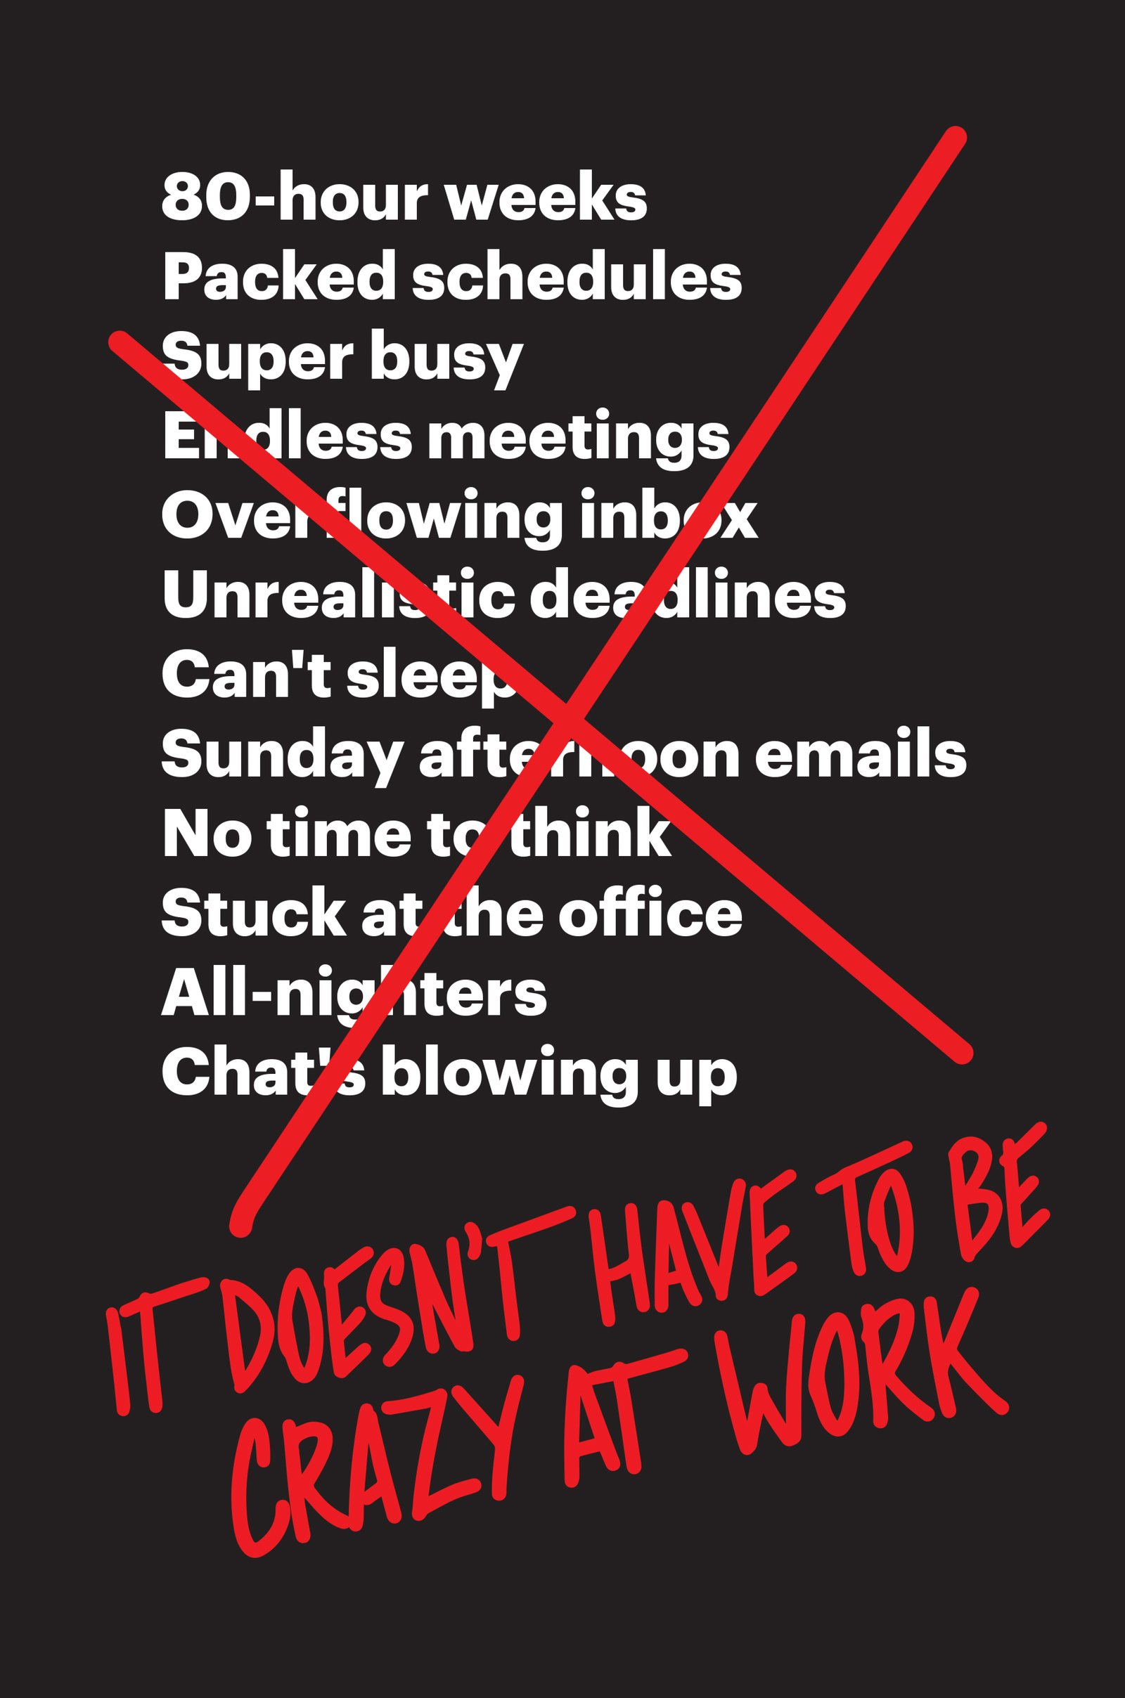
Book Suggestion
Notes:
Book Link: https://www.amazon.com/Doesnt-Have-Be-Crazy-Work/dp/0062874780

Slide 94
Grounds for anti-Stress
Sleep
Nutrition
Nutrition
Sleep
Nutrition
Sleep
Nutrition
Nutrition
Fitness
Fitness
Fitness
Work
Work
Fitness
Work
Fitness
Work
Work

Slide 95
Are there any gotchas?
Yes, there are

Slide 96
Receipts for Failure
Dogmatism
Jumping Too Fast
Not Having Goals
Fighting Your Nature
Notes:
Following diets and practices by the book is never a good idea - in life, at work, or anywhere else
Overdoing it is a bad idea
Analogy: running marathon without training
will complete, but will not be able to do anything for days
You need to have goals to succeed (simpler the better)
Don`t fight your nature, work with it
remember Habits Loop

Slide 97

Book Suggestion
Notes:
Book Link: https://www.amazon.com/Own-Day-Your-Life-Optimized/dp/0062684078

Slide 98
There is so much information
Who do we trust?
Notes:
Why should you even trust me?

Slide 99
Recommendations
Find Specialist
Talk to Professional
Experiment
Share your Experience
Notes:
Find someone you can trust (someone who resonates with you and your style)
Example: I trust Ben Greenfield, and if I search for “Are nuts healthy” I would include his name in the search query
Do blood work, talk to professional
Experiment with different foods and see what works for you
Share your experience - there are many people like you, and they would want to learn from and with you

Slide 100
To that last point of sharing
What makes them stick
Skipped major part of habits

Slide 101
Beliefs
Find Inspiration
Find Purpose
Find Community
Notes:
I was lucky to have a colleague of mine who inspired me to actually try to change my habits
I hope to inspire some of you as well
Mentioned purpose and goals before
Even pairs will be enough
go to meetup, run after work, etc.
References back to the idea of motivators

Slide 102
Call For Action
Find Purpose
Inspire and be Inspired
Enjoy Life
Notes:
Want to reiterate

Slide 103
Q/A

Slide 104
Contact Speaker
Twitter: @DmitryVinnik
LinkedIn: in/dmitry-vinnik/
Email: dmitry@dvinnik.com

